Slide 1


f | Assiut University Faculty of Computers and Information Second Level – First Term 2021/2022
[HU-101]
Cloud computing
Direct By
Team Members:
Team 15:
عبدالرحمن صلاح الدين سعد محمود بنداري سيكشن 9
عبدالرحمن عبدالماجد يوسف نوح سيكشن 9
عبدالرحمن فتحي أبوزيد عبدالسلام سيكشن 9
عبدالله عبدالصبور علي محمد سيكشن 9
عبدالله عبدالعال محمد مدني سيكشن 9
أحمد عرابي مبارك عرابي سيكشن 2
Supervised by:
Dr. Ibrahim El-Semman

Slide 2
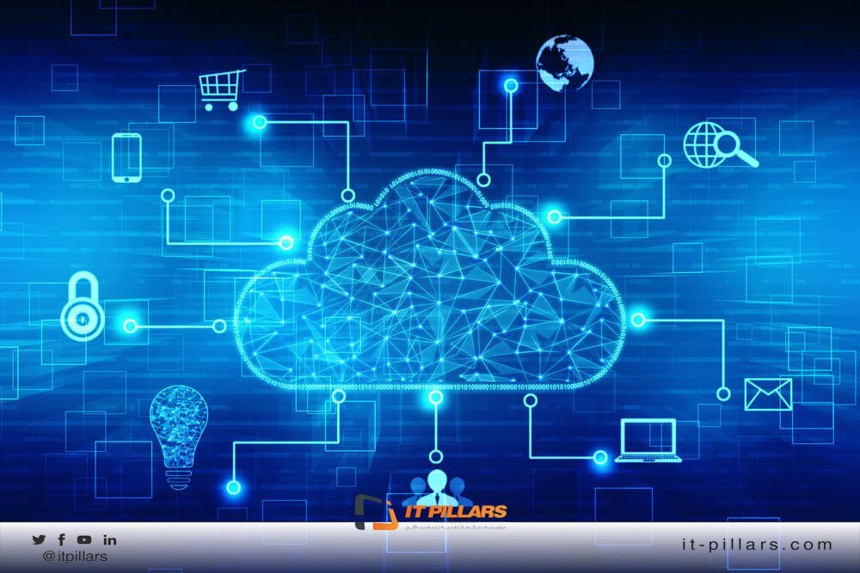

Slide 3
Introduction to cloud computing
Summary
Simply put, cloud computing is the delivery of computing services—including servers, storage, databases, networking, software, analytics, and intelligence—over the Internet (“the cloud”) to offer faster innovation, flexible resources.
Cloud computing is a growing idea in the world of IT, born out of the necessity for computing on the go. It brings the user access to data, applications and storage that are not stored on their computer. For a very simple cloud computing overview, it can be understood as a delivery system that delivers computing the same way a power grid delivers electricity. To the average computer user it offers the advantage of delivering IT without the user having to have an in depth knowledge of the technology. Similar to the way a consumer can access electricity without being an electrician.

Slide 4
Table of Contents
5 – 8 what is cloud computing ?
9 – 11 Basic concepts and Deployment models
12 – 19 Service models and Bost LAAS providers
20 – 26 Virtualization , Opportunities and Challenges
27 – 30 Benefits and Future

Slide 5
What is Cloud Computing?
Cloud Computing is a general term used to describe a new class of network based computing that takes place over the Internet,
basically a step on from Utility Computing
a collection/group of integrated and networked hardware, software and Internet infrastructure (called a platform).
Using the Internet for communication and transport provides hardware, software and networking services to clients
These platforms hide the complexity and details of the underlying infrastructure from users and applications by providing very simple graphical interface or API (Applications Programming Interface).

Slide 6
What is Cloud Computing?
In addition, the platform provides on demand services, that are always on, anywhere, anytime and any place.
Pay for use and as needed, elastic
scale up and down in capacity and functionalities
The hardware and software services are available to
general public, enterprises, corporations and businesses markets

Slide 7
What is Cloud Computing?
Cloud computing is an umbrella term used to refer to Internet based development and services
A number of characteristics define cloud data, applications services and infrastructure:
Remotely hosted: Services or data are hosted on remote infrastructure.
Ubiquitous: Services or data are available from anywhere.
Commodified: The result is a utility computing model similar to traditional that of traditional utilities, like gas and electricity - you pay for what you would want!

Slide 8
What is Cloud Computing?
Many companies are delivering services from the cloud. Some notable examples include the following:
• Google — Has a private cloud that it uses for delivering Google Docs and many other services to its users, including email access, document applications, text translations, maps, web analytics, and much more.
• Microsoft — Has Microsoft® Office 365® online service that allows for content and business intelligence tools to be moved into the cloud, and Microsoft currently makes its office applications available in a cloud.
• Salesforce.com — Runs its application set for its customers in a cloud, and its Force.com and Vmforce.com products provide developers with platforms to build customized cloud services.

Slide 9
Basic Concepts
There are certain services and models working behind the scene making the cloud computing feasible and accessible to end users.
Following are the working models for cloud computing:
1. Deployment Models
2. Service Models

Slide 10
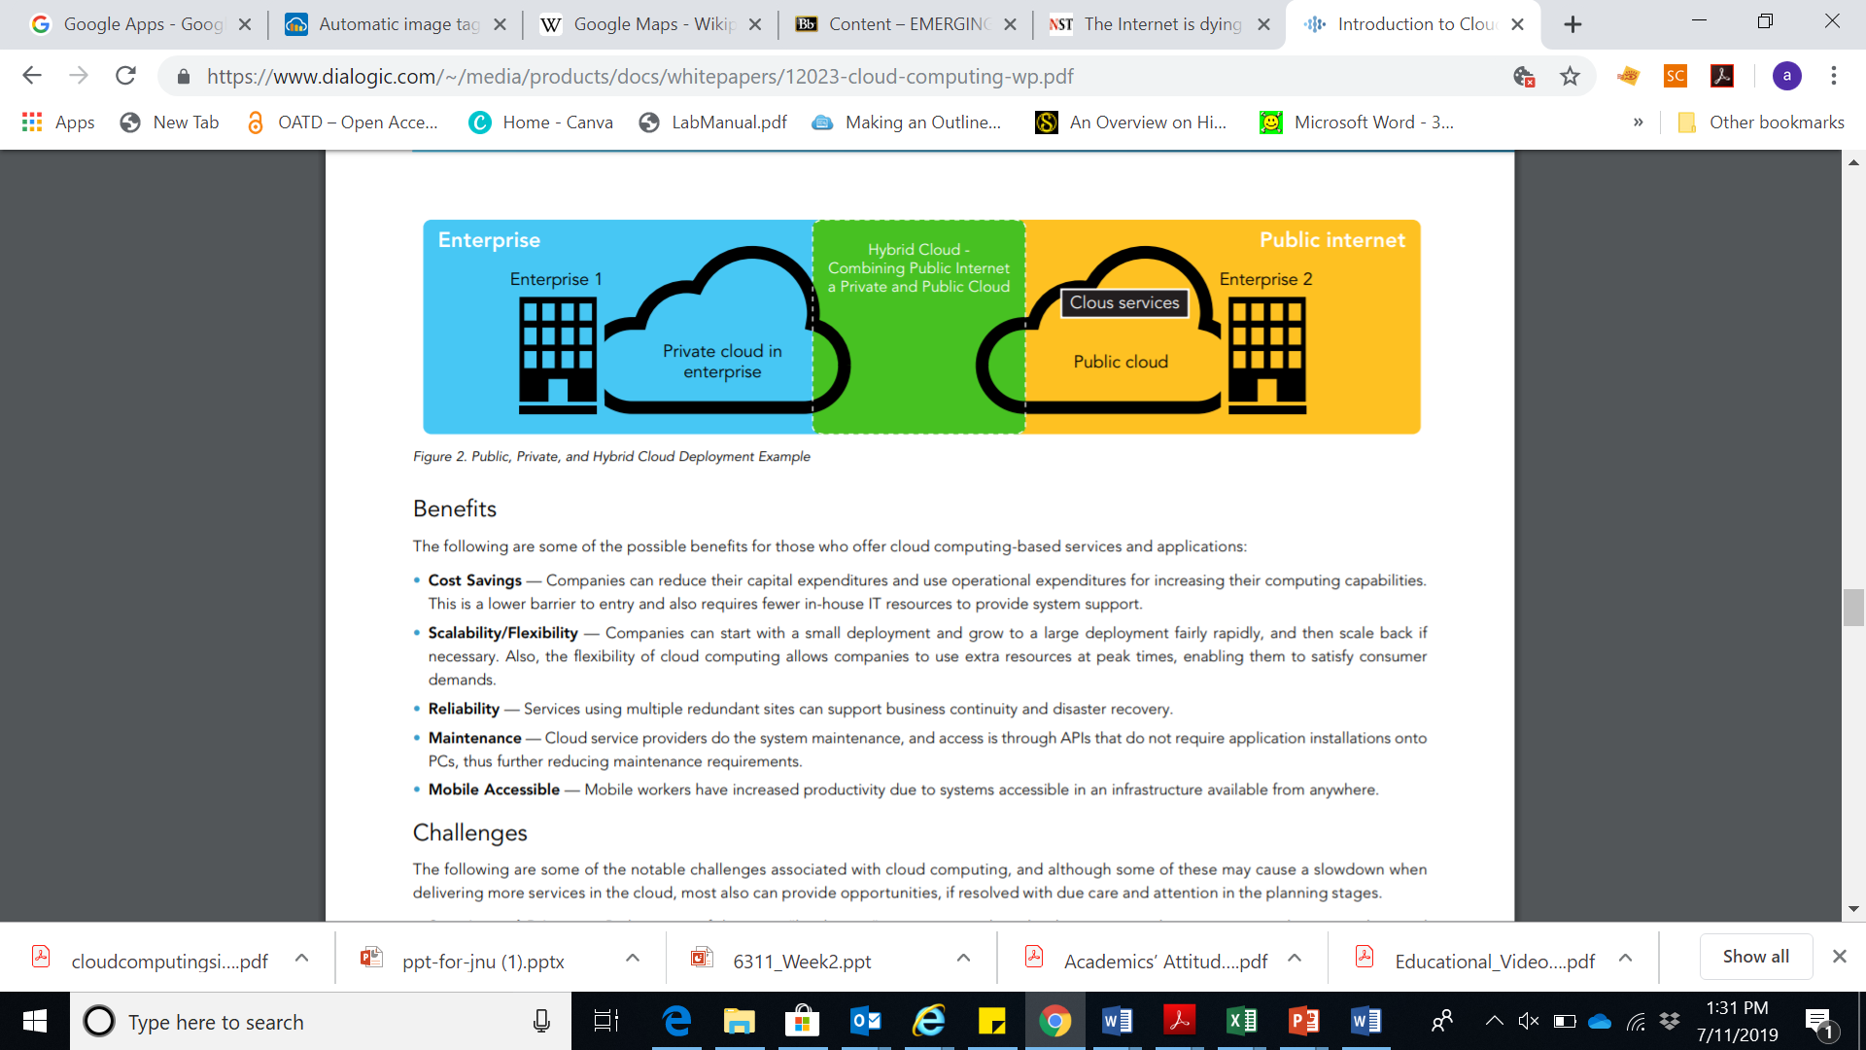
Deployment Models
Deployment models define the type of access to the cloud, i.e., how the cloud is located?
Cloud can have any of the four types of access: Public, Private, Hybrid and Community.

Slide 11
Deployment Models
PUBLIC CLOUD : The Public Cloud allows systems and services to be easily accessible to the general public. Public cloud may be less secure because of its openness, e.g., e-mail.
PRIVATE CLOUD : The Private Cloud allows systems and services to be accessible within an organization. It offers increased security because of its private nature.
COMMUNITY CLOUD : The Community Cloud allows systems and services to be accessible by group of organizations.
HYBRID CLOUD : The Hybrid Cloud is mixture of public and private cloud. However, the critical activities are performed using private cloud while the non-critical activities are performed using public cloud.

Slide 12
Service Models
Service Models are the reference models on which the Cloud Computing is based.
These can be categorized into three basic service models as listed below:
1. Infrastructure as a Service (IaaS)
2. Platform as a Service (PaaS)
3. Software as a Service (SaaS)

Slide 13
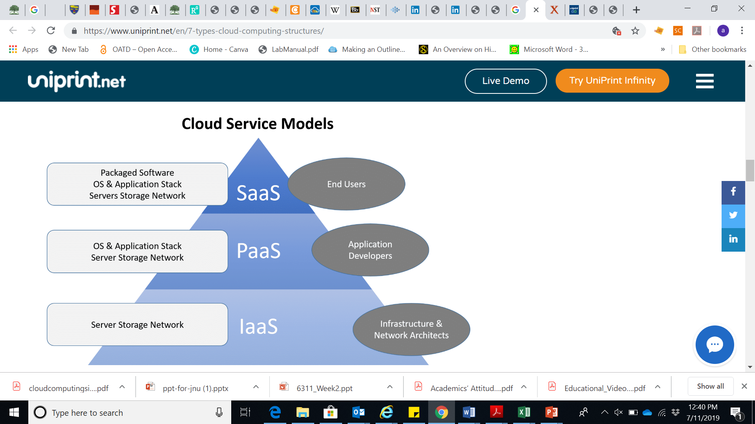

Slide 14
Infrastructure as a Service (IaaS)
IaaS is the delivery of technology infrastructure as an on demand scalable service. IaaS provides access to fundamental resources such as physical machines, virtual machines, virtual storage, etc.
•Usually billed based on usage
•Usually multi tenant virtualized environment
•Can be coupled with Managed Services for OS and application support.

Slide 15
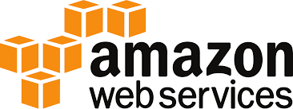
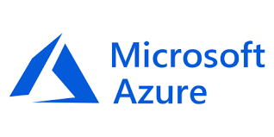
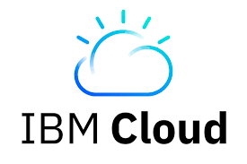
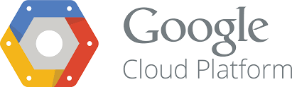
Best IaaS providers of 2019

Slide 16
Platform as a Service (PaaS)
PaaS provides the runtime environment for applications, development & deployment tools, etc. PaaS provides all of the facilities required to support the complete life cycle of building and delivering web applications and services entirely from the Internet.
Typically applications must be developed with a particular platform in mind.
•Multi tenant environments
•Highly scalable multi tier architecture

Slide 17

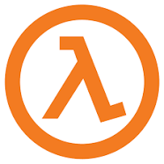
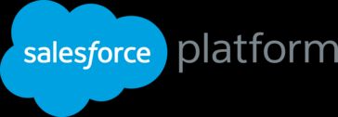
Top Paas Provider 2019
Morpheus
AWS Lambda

Slide 18
Software as a Service (SaaS)
SaaS model allows to use software applications as a service to end users. SaaS is a software delivery methodology that provides licensed multi-tenant access to software and its functions remotely as a Web-based service.
• Usually billed based on usage
• Usually multi tenant environment
• Highly scalable architecture

Slide 19
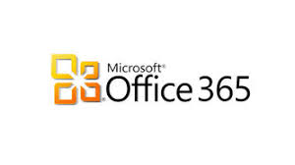
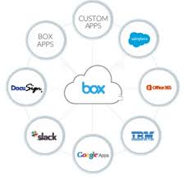
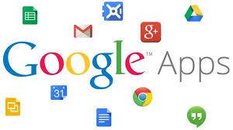
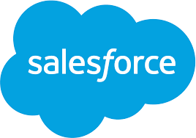
Top Saas for Company

Slide 20
Virtualization
Virtual workspaces:
An abstraction of an execution environment that can be made dynamically available to authorized clients by using well-defined protocols,
Resource quota (e.g. CPU, memory share),
Software configuration (e.g. O/S, provided services).
Implement on Virtual Machines (VMs):
Abstraction of a physical host machine,
Hypervisor intercepts and emulates instructions from VMs, and allows management of VMs,
VMWare, Xen, etc.
Provide infrastructure API:
Plug-ins to hardware/support structures

Slide 21
Virtualization in General
Advantages of virtual machines:
Run operating systems where the physical hardware is unavailable,
Easier to create new machines, backup machines, etc.,
Software testing using “clean” installs of operating systems and software,
Emulate more machines than are physically available,
Timeshare lightly loaded systems on one host,
Debug problems (suspend and resume the problem machine),
Easy migration of virtual machines (shutdown needed or not).
Run legacy systems!

Slide 22
What is the purpose and benefits?
Cloud computing enables companies and applications, which are system infrastructure dependent, to be infrastructure-less.
By using the Cloud infrastructure on “pay as used and on demand”, all of us can save in capital and operational investment!
Clients can:
Put their data on the platform instead of on their own desktop PCs and/or on their own servers.
They can put their applications on the cloud and use the servers within the cloud to do processing and data manipulations etc.

Slide 23
Cloud-Sourcing
Why is it becoming a Big Deal:
Using high-scale/low-cost providers,
Any time/place access via web browser,
Rapid scalability; incremental cost and load sharing,
Can forget need to focus on local IT.
Concerns:
Performance, reliability, and SLAs,
Control of data, and service parameters,
Application features and choices,
Interaction between Cloud providers,
No standard API – mix of SOAP and REST!
Privacy, security, compliance, trust…

Slide 24
Opportunities and Challenges
The use of the cloud provides a number of opportunities:
It enables services to be used without any understanding of their infrastructure.
Cloud computing works using economies of scale:
It potentially lowers the outlay expense for start up companies, as they would no longer need to buy their own software or servers.
Cost would be by on-demand pricing.
Vendors and Service providers claim costs by establishing an ongoing revenue stream.
Data and services are stored remotely but accessible from “anywhere”.

Slide 25
Opportunities and Challenges
In parallel there has been backlash against cloud computing:
Use of cloud computing means dependence on others and that could possibly limit flexibility and innovation:
The others are likely become the bigger Internet companies like Google and IBM, who may monopolise the market.
Some argue that this use of supercomputers is a return to the time of mainframe computing that the PC was a reaction against.
Security could prove to be a big issue:
It is still unclear how safe out-sourced data is and when using these services ownership of data is not always clear.

Slide 26
Opportunities and Challenges
There are also issues relating to policy and access:
If your data is stored abroad whose policy do you adhere to?
What happens if the remote server goes down?
How will you then access files?
There have been cases of users being locked out of accounts and losing access to data.

Slide 27
Benefits
• Cost Savings — Companies can reduce their capital expenditures and use operational expenditures for increasing their computing capabilities. This is a lower barrier to entry and also requires fewer in-house IT resources to provide system support.
• Scalability/Flexibility — Companies can start with a small deployment and grow to a large deployment fairly rapidly, and then scale back if necessary. Also, the flexibility of cloud computing allows companies to use extra resources at peak times, enabling them to satisfy consumer demands.
• Reliability — Services using multiple redundant sites can support business continuity and disaster recovery.
• Maintenance — Cloud service providers do the system maintenance, and access is through APIs that do not require application installations onto PCs, thus further reducing maintenance requirements.
• Mobile Accessible — Mobile workers have increased productivity due to systems accessible in an infrastructure available from anywhere.

Slide 28
Disadvantages of Cloud Computing
Requires a constant Internet connection:
Cloud computing is impossible if you cannot connect to the Internet.
Since you use the Internet to connect to both your applications and documents, if you do not have an Internet connection you cannot access anything, even your own documents.
A dead Internet connection means no work and in areas where Internet connections are few or inherently unreliable, this could be a deal-breaker.

Slide 29
Disadvantages of Cloud Computing
Stored data might not be secure:
With cloud computing, all your data is stored on the cloud.
The questions is How secure is the cloud?
Can unauthorised users gain access to your confidential data?
Stored data can be lost:
Theoretically, data stored in the cloud is safe, replicated across multiple machines.
But on the off chance that your data goes missing, you have no physical or local backup.
Put simply, relying on the cloud puts you at risk if the cloud lets you down.

Slide 30
The Future
Many of the activities loosely grouped together under cloud computing have already been happening and centralised computing activity is not a new phenomena
Grid Computing was the last research-led centralised approach
However there are concerns that the mainstream adoption of cloud computing could cause many problems for users
Many new open source systems appearing that you can install and run on your local cluster
should be able to run a variety of applications on these systems

Slide 31
References
“Cloud Computing: Concepts, Technology & Architecture” by Thomas Erl
“The Little Book of Cloud Computing” by Lars Nielsen
“Cloud Computing Explained” by John Rhoton
“Cloud Computing for Programmers” by Daniele Casal
“Cloud Computing For Dummies” by Judith Hurwitz
“Cloud Computing: From Beginning to End” by Mr Ray J Rafaels
“Cloud Computing (The MIT Press Essential Knowledge series)” by Nayan B Ruparelia
“Cloud Computing: Concepts, Technology and Architecture” by Thomas Erl and Ricardo Puttini
“Cloud Computing – An Introduction” by subu sangameswar
“Cloud Computing: A Hands-On Approach” by Arshdeep Bahga and Vijay Madisetti.

